Slide 1
Effective Density Visualization of Multiple Overlapping Axis-aligned Objects
MSc. Thesis of Niloy Eric Costa
York University, Toronto, Canada

Slide 2
Background

Slide 3
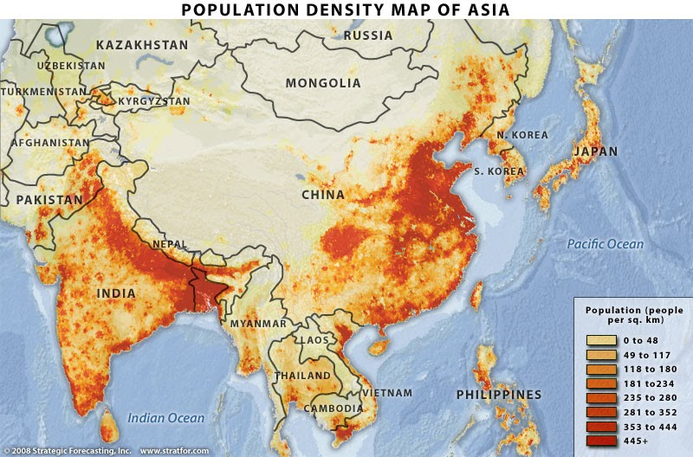
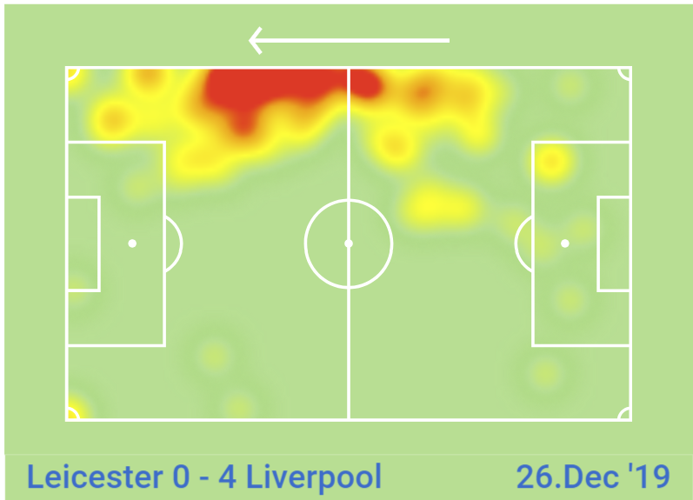
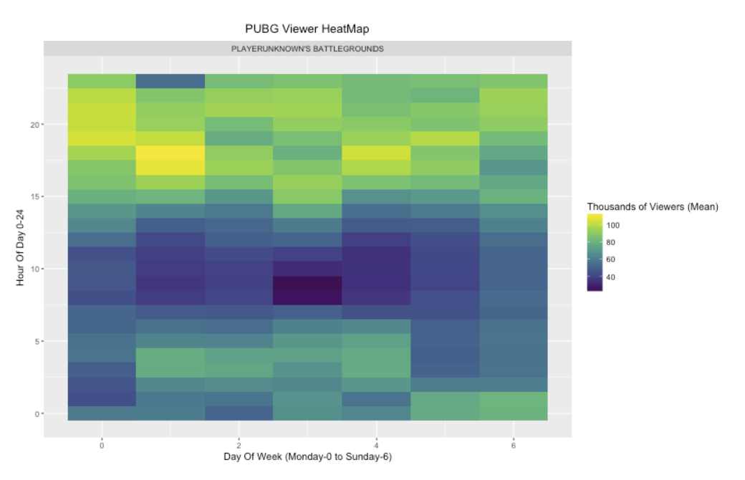
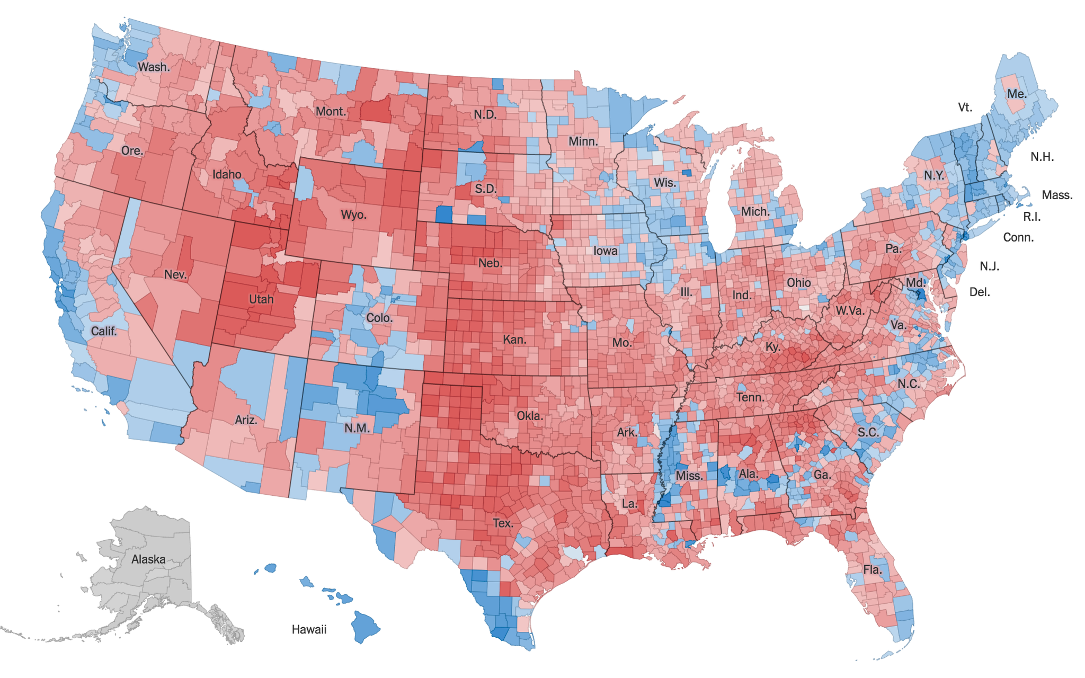
Density-based visualization
Activity Map
2012 US Election
Notes:
Density based is used to declutter scatterplots. Instead of plotting each points individually, density-based techniques helps us show the underlying trends and patters in the data-set.
First one- shows the 3 billions people in asia.
Second one- shows activity of one football player in one game.
Third one- shows highest density when people streams their game, in this case, PUBG.
Fourth one- 2012 US election where the blues won in popular vote.

Slide 4
Observation
Many data analytics problems
need to visualize the density of
axis-aligned objects
Notes:
Our first observation is – many data mining problems use the abstraction of axis aligned objects to inform computational insights.

Slide 5
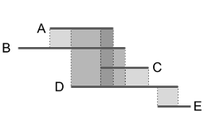
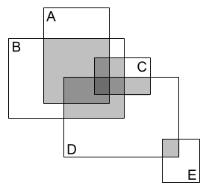
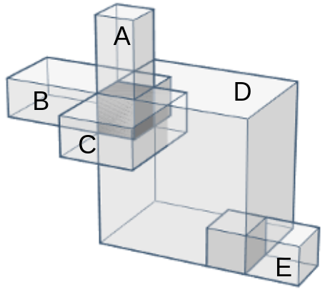
Axis-aligned geometric objects
1-D line segments/intervals
2-D rectangles
Need for effective density visualization of multiple overlapping axis-aligned objects
3-D boxes/cuboids
Notes:
1D line segments can be used to abstract events with a start and end time.
2D rectangles can be used as an approximate geographical objects, VLSI design and so on

Slide 6
Research questions
1. How to detect multiple overlaps?
How many overlapping elements?
Which rectangles are overlapping?
Size of the overlaps?
2. How to evaluate the efficiency of the methods?
3. What are the real-world use cases for these methods?

Slide 7
Object intersection problem
Input
a set of axis-aligned geometric objects
Output
pairs of intersecting objects
size of overlap
A
(A,B)
(B,C)
C
B
how can we address this problem?

Slide 8
Sweep-line algorithm
L
y⁰
_{A}
A
y⁰
_{B}
y¹
_{A}
y⁰
_{C}
C
y¹
B
_{B}
y¹
_{C}
x⁰
x⁰
x⁰
x¹
x¹
x¹
_{A}
_{B}
_{C}
_{B}
_{A}
_{C}
Sweep direction
an efficient one pass computational geometry algorithm
Notes:
It is a one pass algorithm, this L “conceptual sweep line”
The algorithm first sorts the end points along the x axis from left to right, then a “conceptual sweep line”, L starts from left on the plane and “sweeping”– the plane by moving that line gradually to the right and capturing intersections as we pass through them.
Algo find these points, keeps a set of active elements, when another one is added, then they are intersecting

Slide 9
Multiple Object Intersection Problem

Slide 10
The problem
Input
a set of regions in R²
Output
enumeration of all intersecting regions
size of each common region
position of each common region
(A,B)
(A,C)
(A,D)
(B,C)
(B,D)
(C,D)
(D,E)
(A,B,C)
(A,B,D)
(A,C,D)
(B,C,D)
(A,B,C,D)
Notes:
Our input is a set of regions/ rectangles in space R^2
Output are the spaces shared by all these rectangles

Slide 11
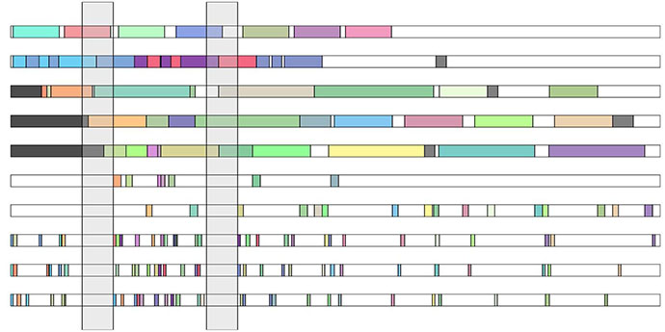
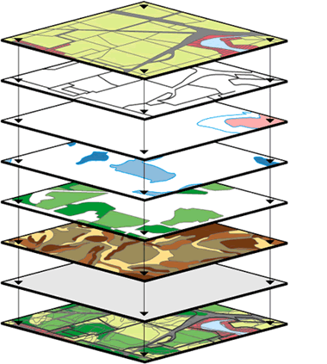
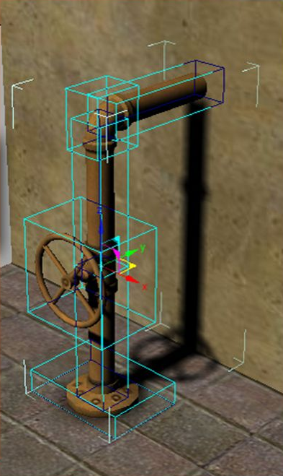
Many applications
task scheduling
spatial databases
simulations

Slide 12
Baseline Methods

Slide 13
Sensible baseline algorithms
Baseline 1: naive algorithm
iteratively check all possible ways that n objects can intersect
(-) limitation
there are 2^{n} ways, so exponential computational cost
Baseline 2: grid-based approach
create a grid, perform orthogonal queries to find objects intersecting with each grid cells, assign value based on intersections
(-) limitation
trade-off between accuracy and time-performance based on grid-cell sizes

Slide 14
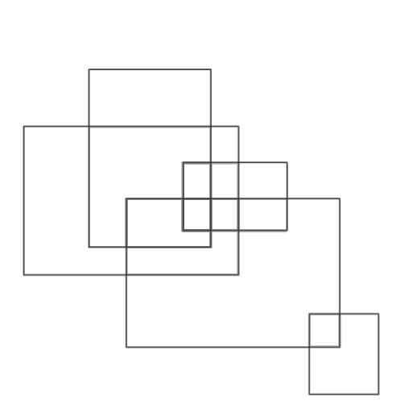
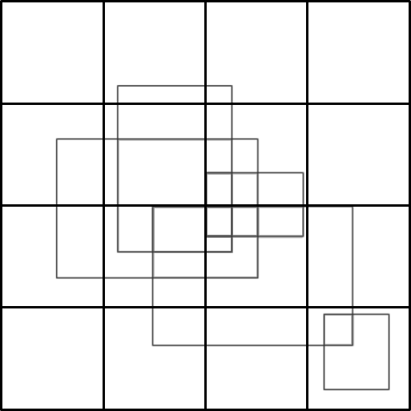
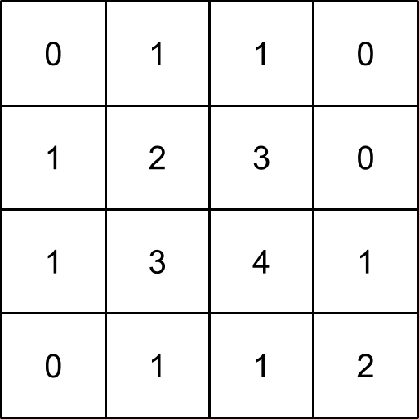
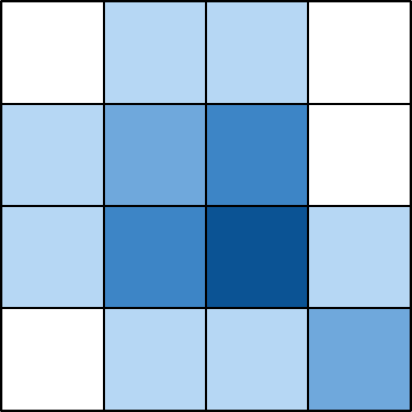
Grid-based approach
Use R-tree* to create a grid
Search in the tree for finding z-index scores
Color each grid-cells based on the corresponding z-index scores
Input data-set
1. 4 X 4 grid
2. z-index scores of cells
3. 4 X 4 grid heat-map
*R-tree is a depth balanced tree, provides aid in faster spatial queries
Notes:
Tree is created by iteratively inserting input rectangles as leaf nodes
While the Root node represents the entire space
Intermediate nodes represent groups of rectangles that lie within a minimum bounding box for each group
Then we query our tree for each cell to find number of intersections aka z index
Finally we color them
Complexity O(nlogn+g^2(logn+k))

Slide 15
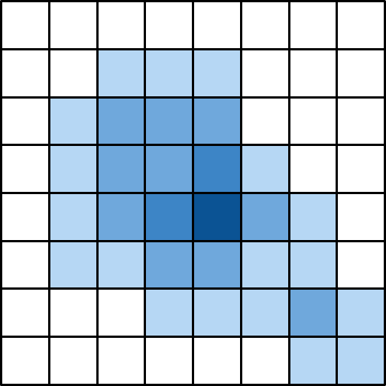
Grid-based approach trade-off
Trade-off
4 X 4 grid is less accurate, but z-indexes calculated quickly
8 X 8 grid is more accurate, took longer to calculate each z-index score

Slide 16
Our Approach (OverLap-HeatMap)

Slide 17
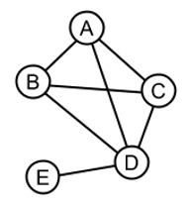
Observation 1
intersections of n-dimensional objects (1-D, 2-D, 3-D, …) can be universally modeled as an intersection graph
intersection graph:
vertex: represents an object
edge: represents that two objects intersect

Slide 18
Observation 2
a k-clique in the intersection graph, corresponds to k objects that are simultaneously intersecting and share a common region

Slide 19
k-clique
a k-clique is a complete subgraph of size k (i.e., a subset of k vertices that are all connected to each other)
2-cliques: all edges
3-cliques: ABC, ABD, ACD, BCA
4-cliques: ABCD (maximal clique)

Slide 20
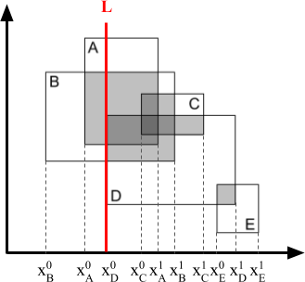
OL-HeatMap* algorithm (sketch)
Apply sweep-line to find intersecting pairs
Construct the rectangle intersection graph (RIG)
Apply a clique enumeration algorithm on graph
(1)
(2)
(3)
(A,B)
(A,C)
(A,D)
(B,C)
(B,D)
(C,D)
(D,E)
(A,B,C)
(A,B,D)
(A,C,D)
(B,C,D)
(A,B,C,D)
*OL-HeatMap is an extended version of SLIG -
Sweep-Line (with an auxiliary) Intersection Graph
By Tilemachos et al.
Notes:
Sweep-line algo is Bently Ottman
Clique enumeration is bron-kerbosch algo –
given three disjoint sets of vertices R, P, and X,
The recursion is initiated by setting R and X to be the empty set and P to be the vertex set of the graph. Within each recursive call, the algorithm considers the vertices in P in turn; if there are no such vertices, it either reports R as a maximal clique (if X is empty), or backtracks. For each vertex v chosen from P, it makes a recursive call in which v is added to R and in which P and X are restricted to the neighbor set N(v) of v, which finds and reports all clique extensions of R that contain v. Then, it moves v from P to X to exclude it from consideration in future cliques and continues with the next vertex in P.
Complexity O(nlogn+n.cmax)

Slide 21
OL-HeatMap: Other metrics computed
z-index
The number of simultaneously overlapping objects in a set
size of overlap(|S|)
For more dimensions, |S| is the product of the common region lengths in each dimension |S_{o}|
z_{ABCD} = 4
z_{DE} = 2
…
|S_{ABCD}|

Slide 22
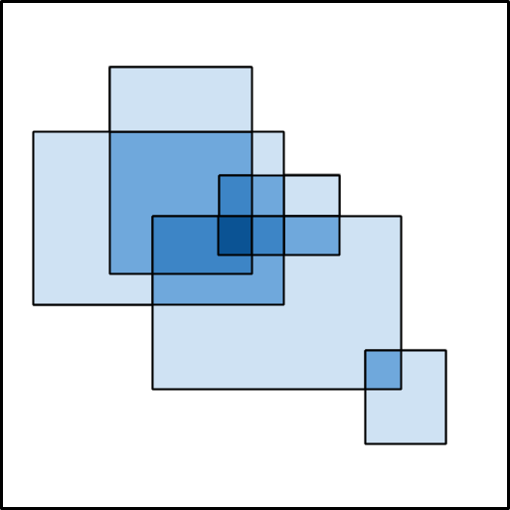
OL-HeatMap: Final visualization
Coloring the boxes
Each common region S should be colored only once based on their intersection cardinality. We skip drawing of rectangles which are completely covered by another.
Currently ~30% less overlaps are colored

Slide 23
Experimental Evaluation

Slide 24
Experiment overview
Accuracy performance
Runtime performance
OL-HeatMap versatility (extension to 1D objects)
OL-HeatMap flexibility (real world use-cases)
OL-HeatMap scalability

Slide 25
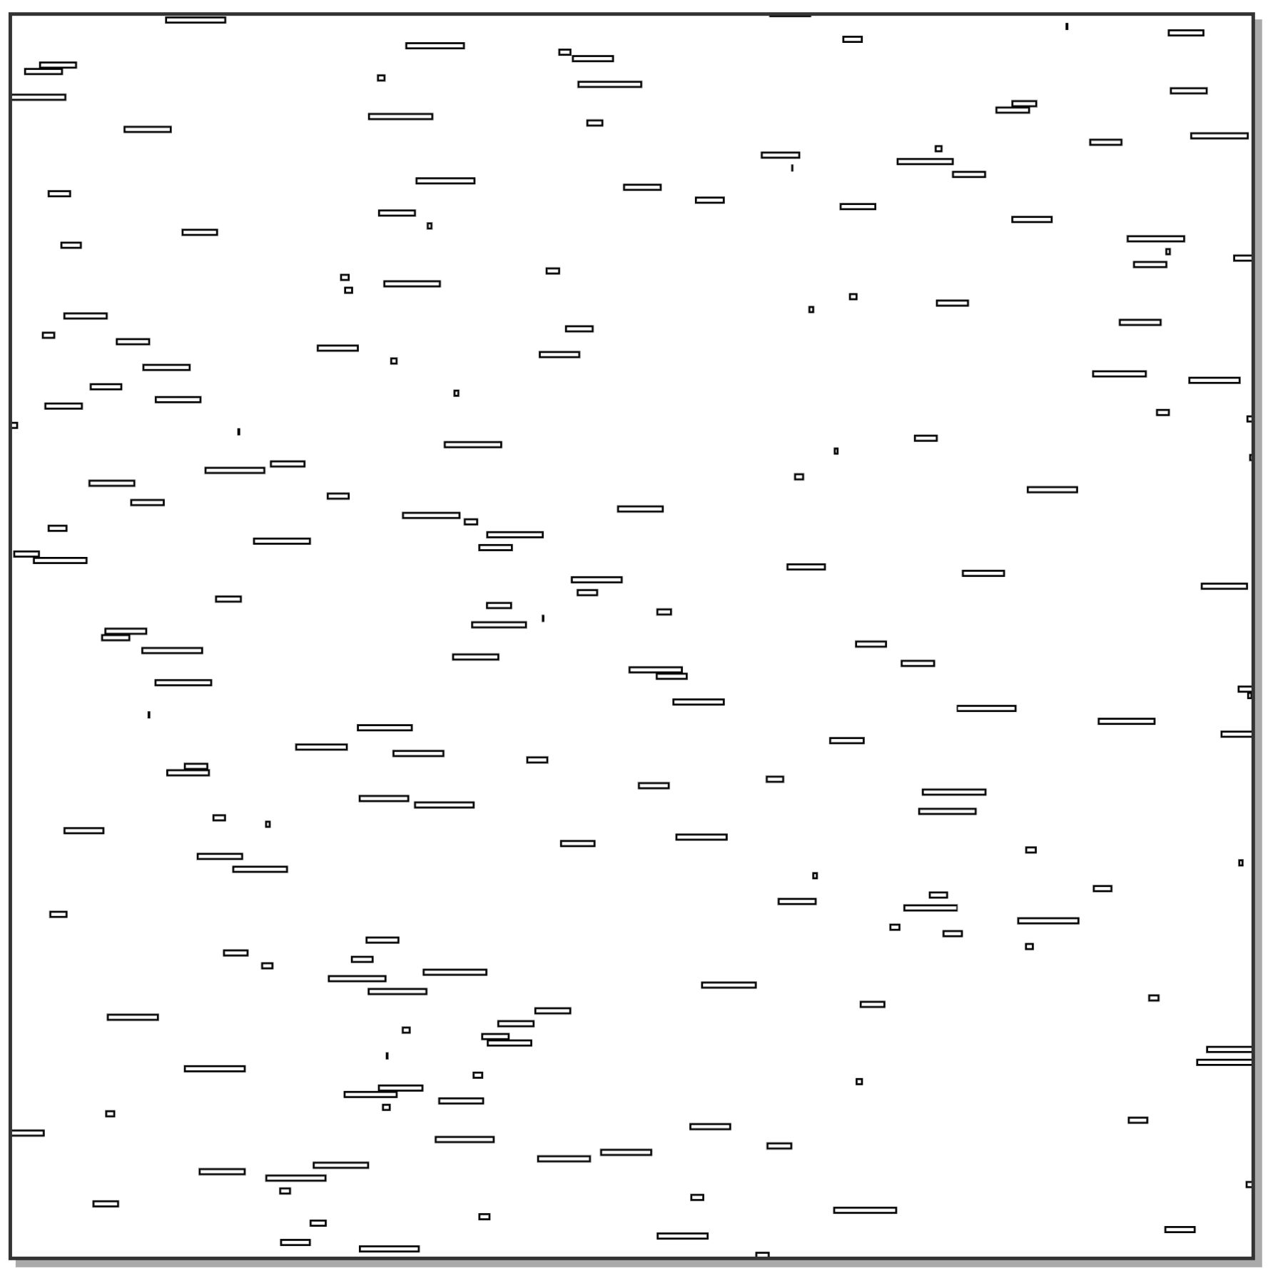
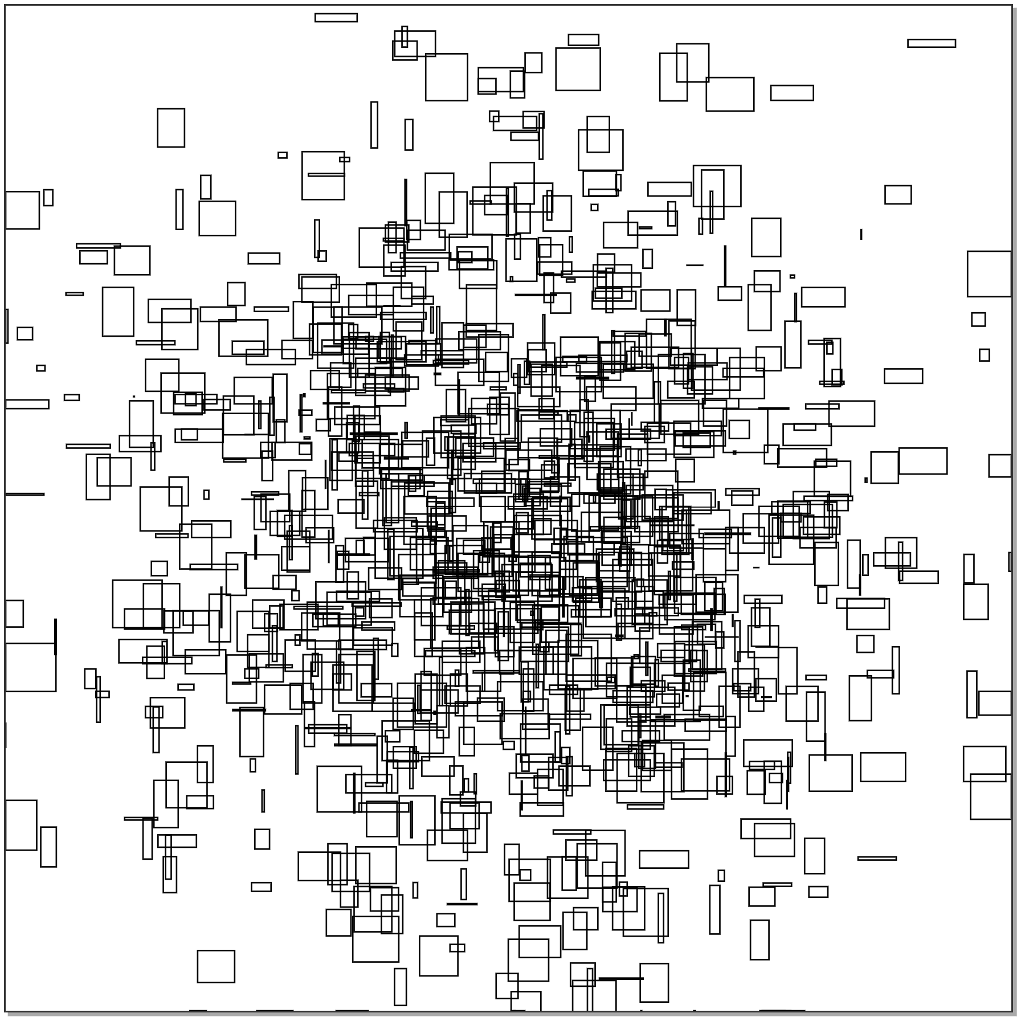
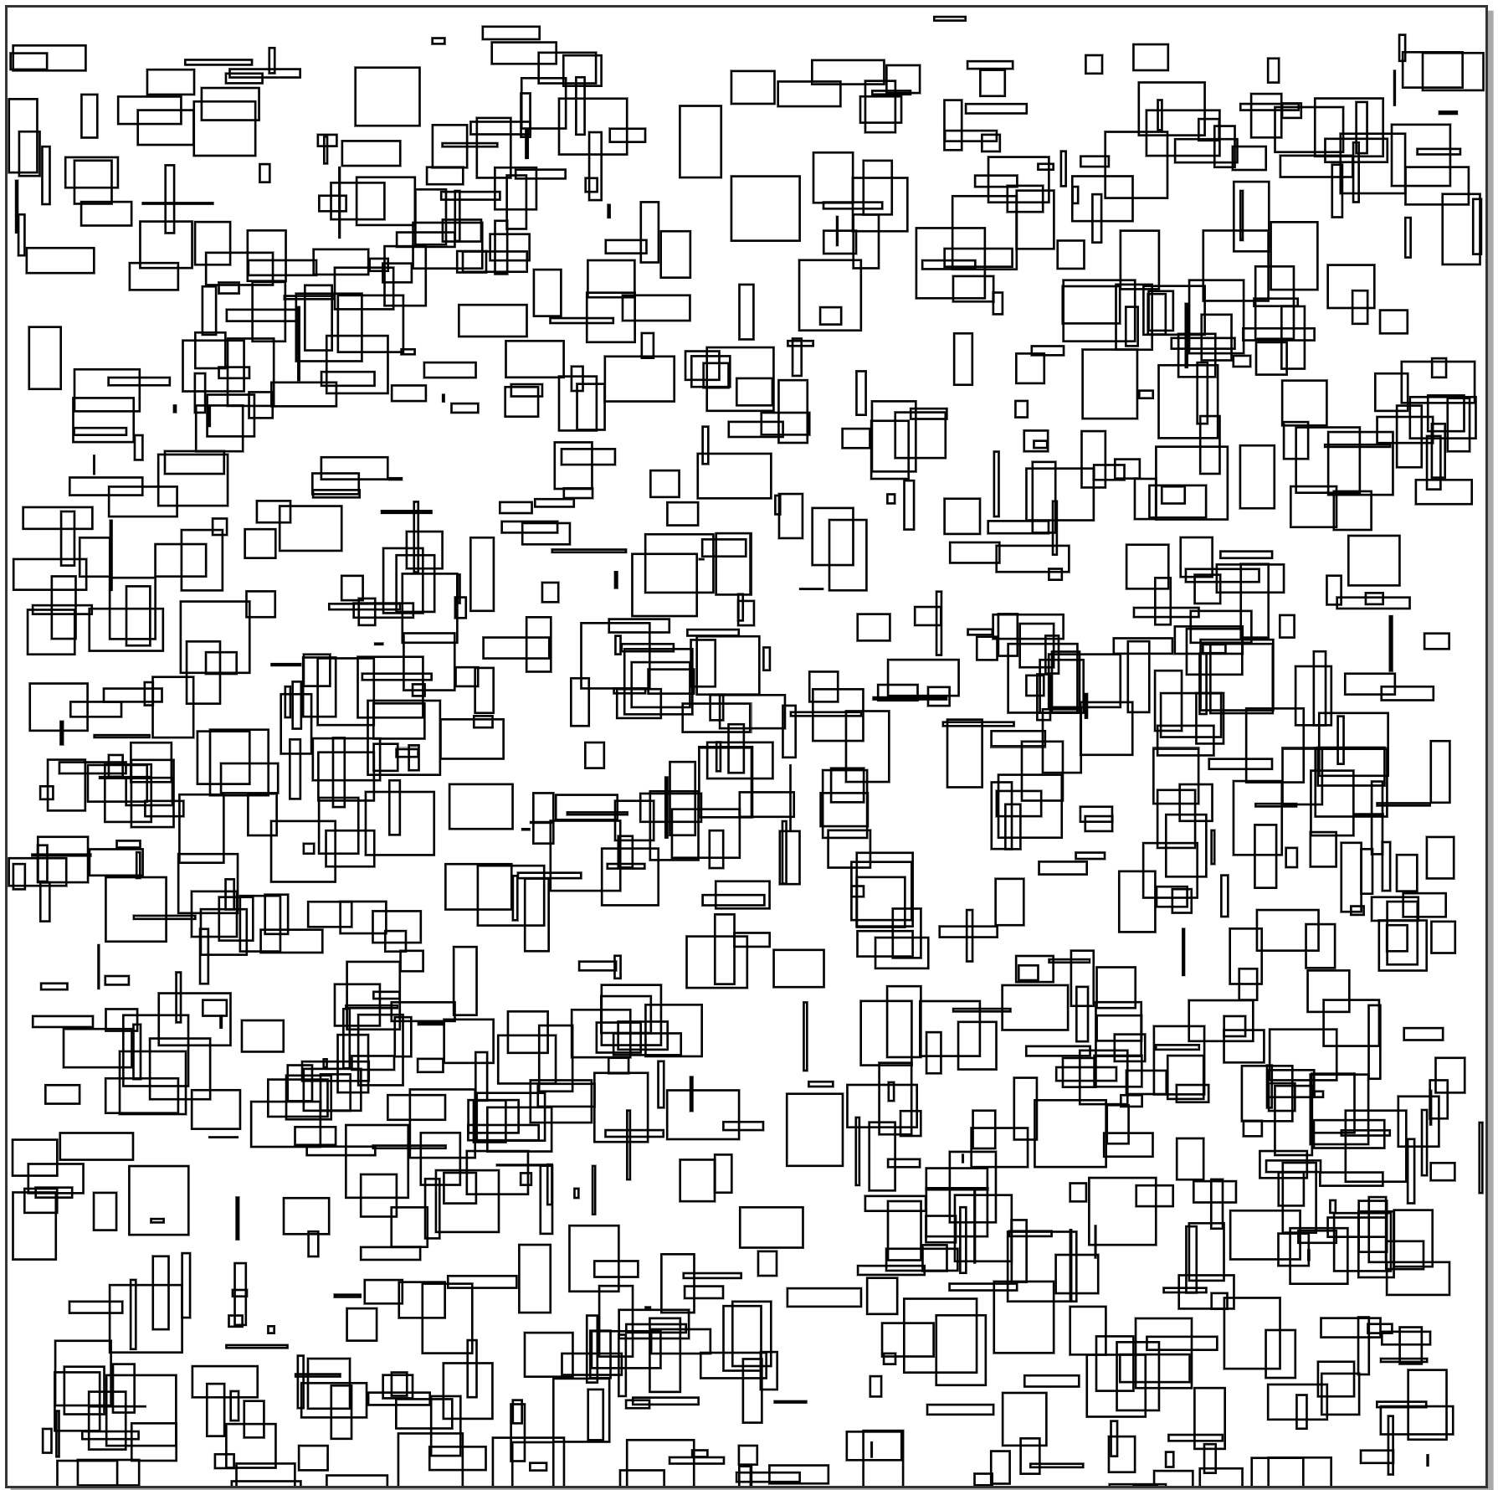
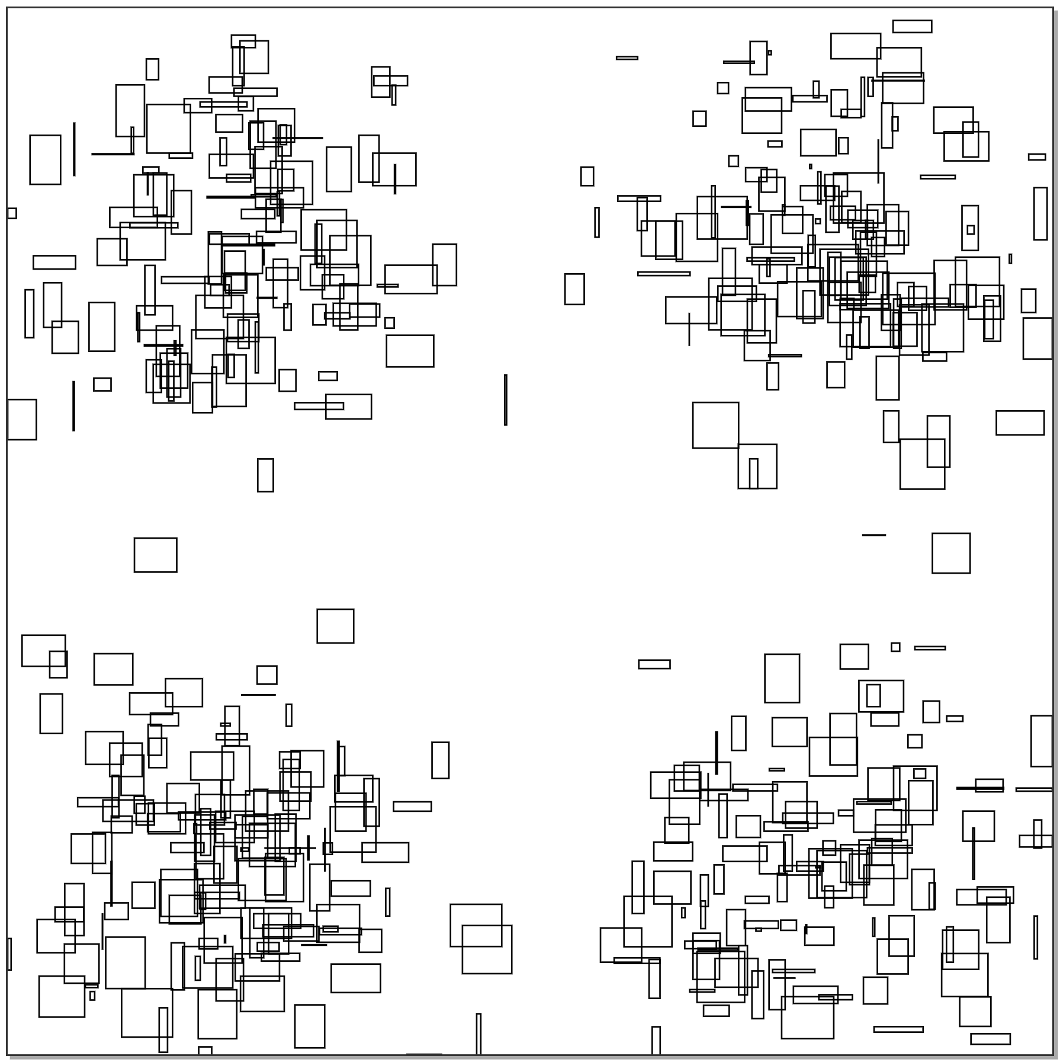
Randomly generated objects
1-D intervals
2-D rectangles – gaussian distribution
2-D rectangles – uniform distribution
2-D rectangles – bi-modal distribution

Slide 26
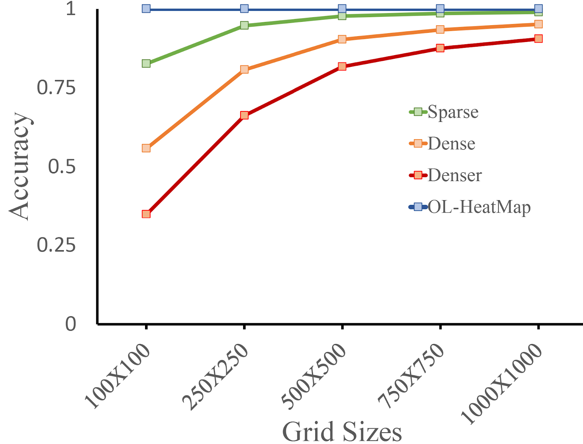
Accuracy
Measurement of accuracy for different grid sizes
Notes:
Fig1 – shows accuracy for different grid sizes. Smaller grids with boxes having less overlaps aka “sparse” line performs as good as OL-HM, while the densely packed boxes have very low accuracy. On the other hand, a finer grid, 1000 by 1000 provides OL-HeatMap like accuracy. Needless to say, OLHM has 100% accuracy in all cases.
Fig2 – As the rectangle number increases, smaller grid sizes become extremely inaccurate.

Slide 27
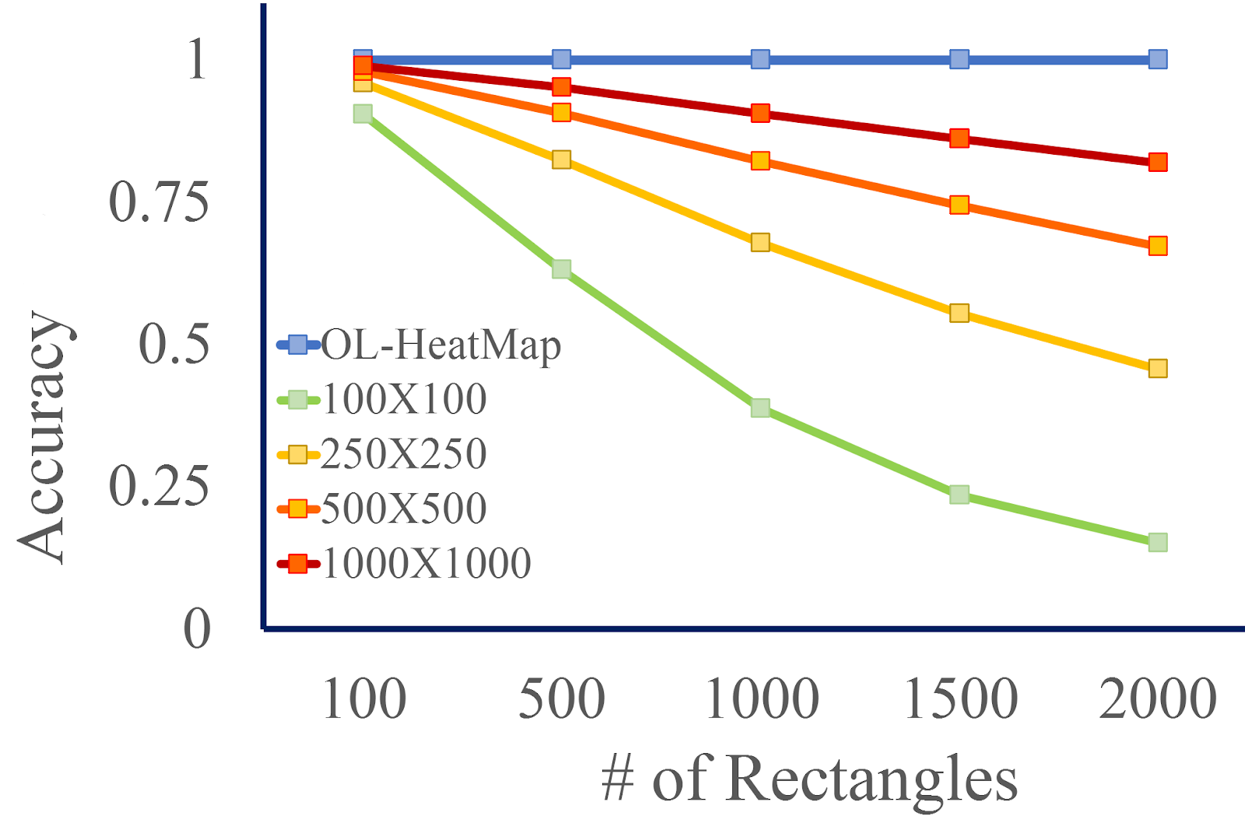
Accuracy
Accuracy performance of OL-HeatMap vs. grid-based
OL-HeatMap is 100% accurate. However, a finer grid can achieve similar accuracy

Slide 28
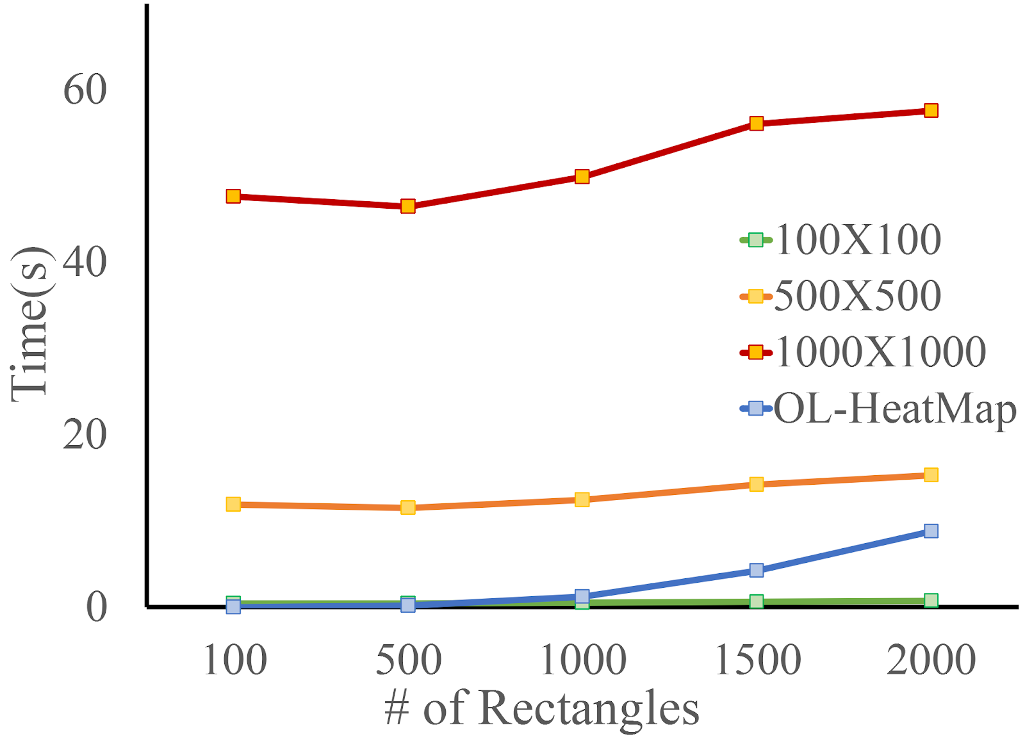
Runtime cost
Comparison of time for different data-set sizes
Notes:
Fig1 – the same 1000 by 1000 grid which provided OL-HeatMap like accuracy performs really bad comparing to OLHM’s time.
Fig2 – in all distributions, OLHM performs with a 100% accuracy and takes lesser time than the smallest grid

Slide 29
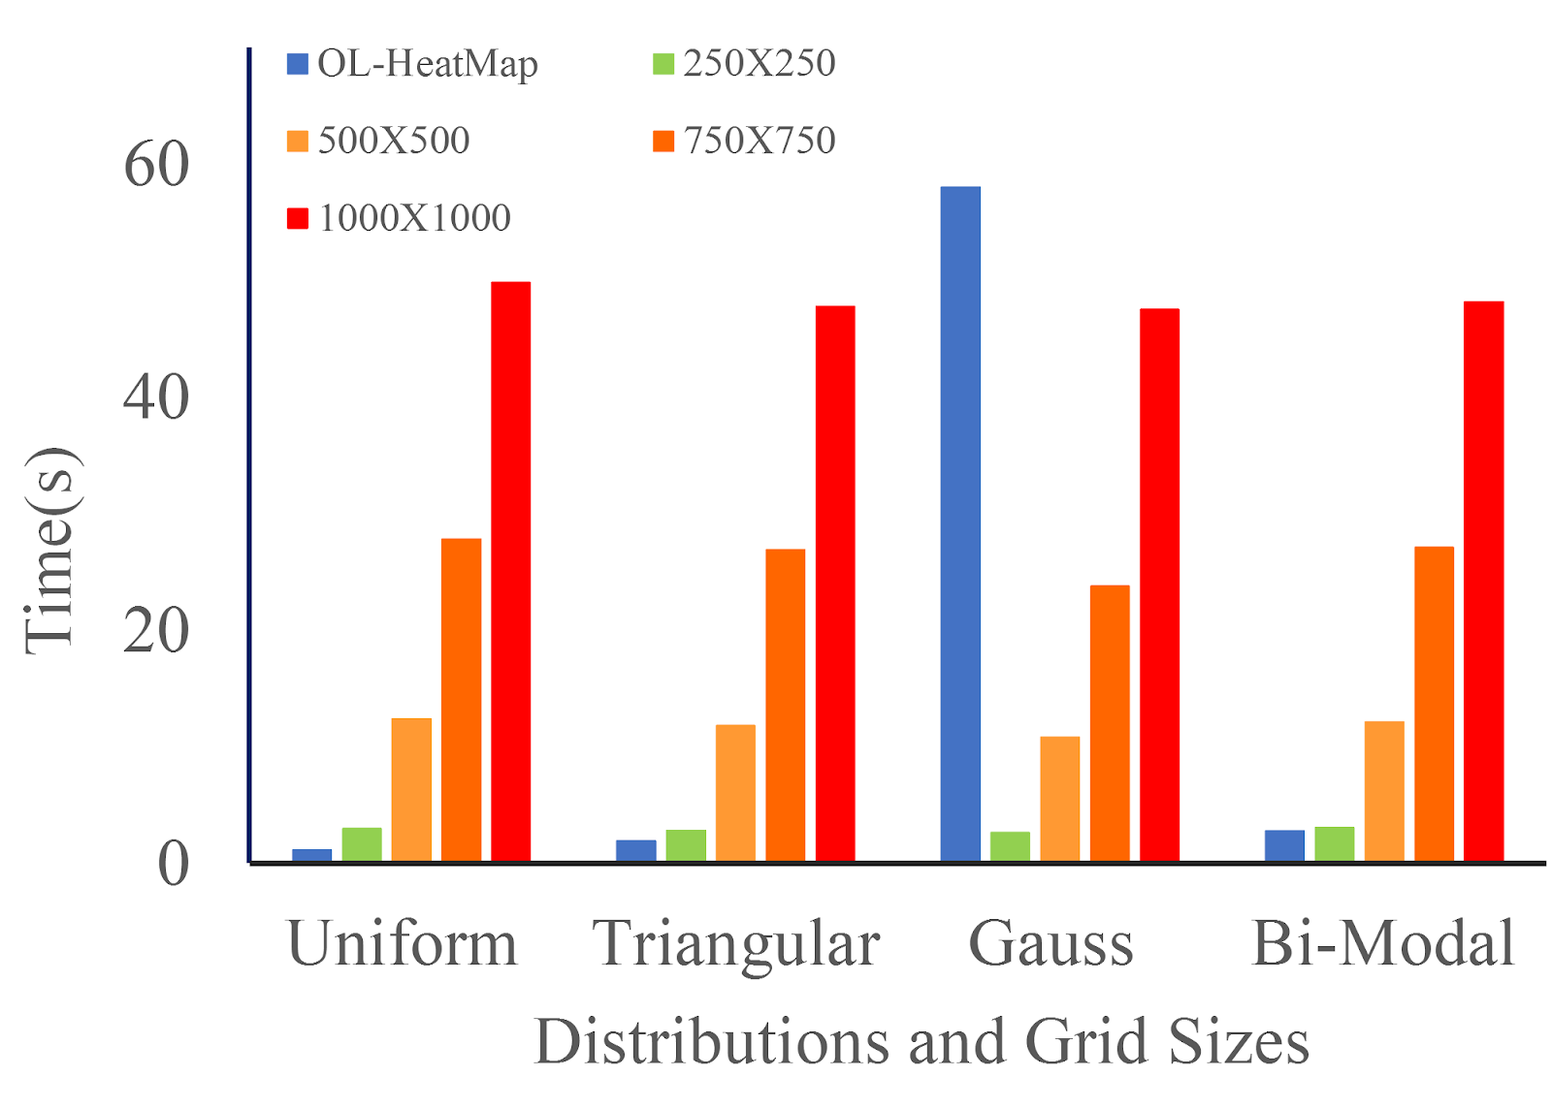
Runtime cost
Comparison of time for different data distributions
Finer grid sizes takes a lot of time to compute in order to achieve similar accuracy that of OL-HeatMap

Slide 30
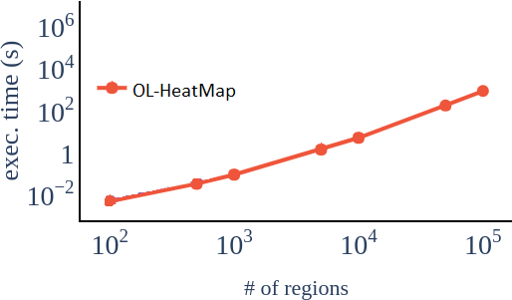
Scalability
Execution Time vs OL-HeatMap Scalability
OL-HeatMap can scale up-to a million regions

Slide 31
Real World Use Cases

Slide 32
Real-world use cases (1D)
The Data
US Airline Carrier Data (1987-present)
We used John Wayne Airport, Orange County, California
1D intervals created by time aircraft spent on runway
Visualization Goal
Find highest density of runway traffic
Finding least used time slot for a runway
Overview of airport usage in a single day (February 1st, 2019)
Providing aid in Air Traffic Management

Slide 33
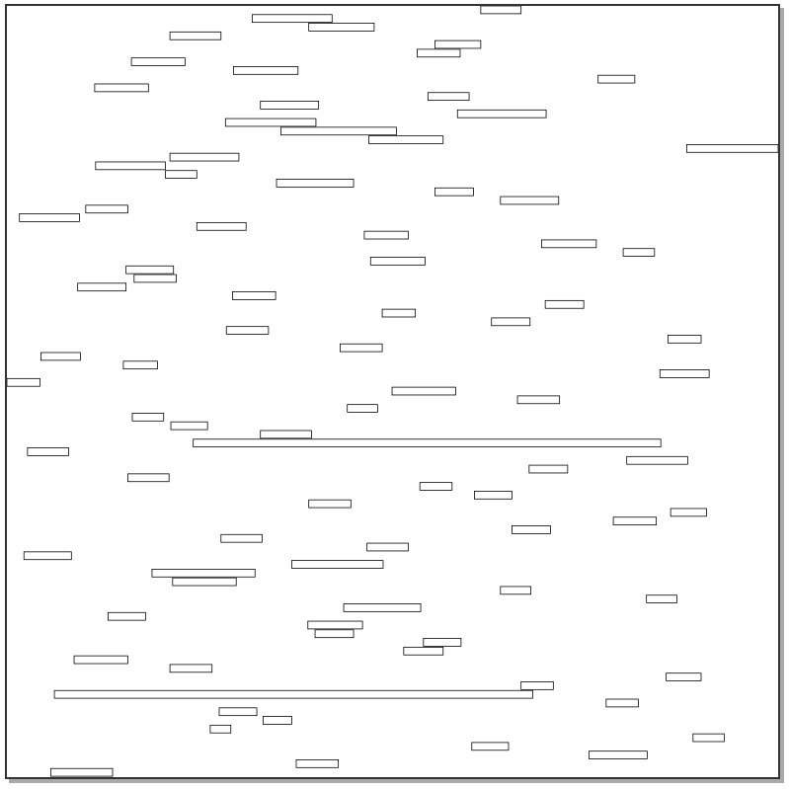
Airline carrier data
Overview of the February 1st, 2019
Time Left to Right –
0000 – 2359 Hours
Notes:
Each line depicts one aircraft’s time spent at runway

Slide 34
Airline carrier data
100 Grid. Time - 0000-2359 Hours [24 Minute Intervals]
50 Grid. Time - 0000-2359 Hours [48 Minute Intervals]
OL-HeatMap. Time - 0000-2359 Hours
Notes:
Observation – thick grids shows that a peak traffic period which is significantly bigger than the actual one

Slide 35
Real-world use cases (2D)
The Data
US Storm Events Database, NOAA (1953-present).
Relevant information regarding significant weather event.
Begin Long., Lat., and End Long., Lat. Used to create bounding boxes
Visualization Goal
Determining storm hot-spots in US during 2017-2019
Finding states with less severe weather incidents
Finding the borders of “Tornado Alley”
Visualize using OL-HeatMap to show the sizes, density and severity of these events
Finding all hurricanes in Florida from 1953-2018 {Using a subset of the entire dataset}

Slide 36
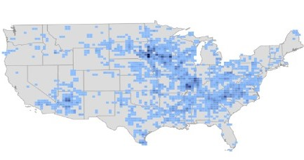
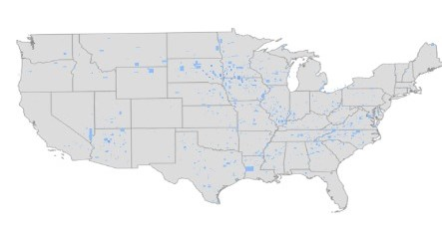
US storm events database
Grid-based visualization
OL-HeatMap
Storms in US [2017-2019]

Slide 37
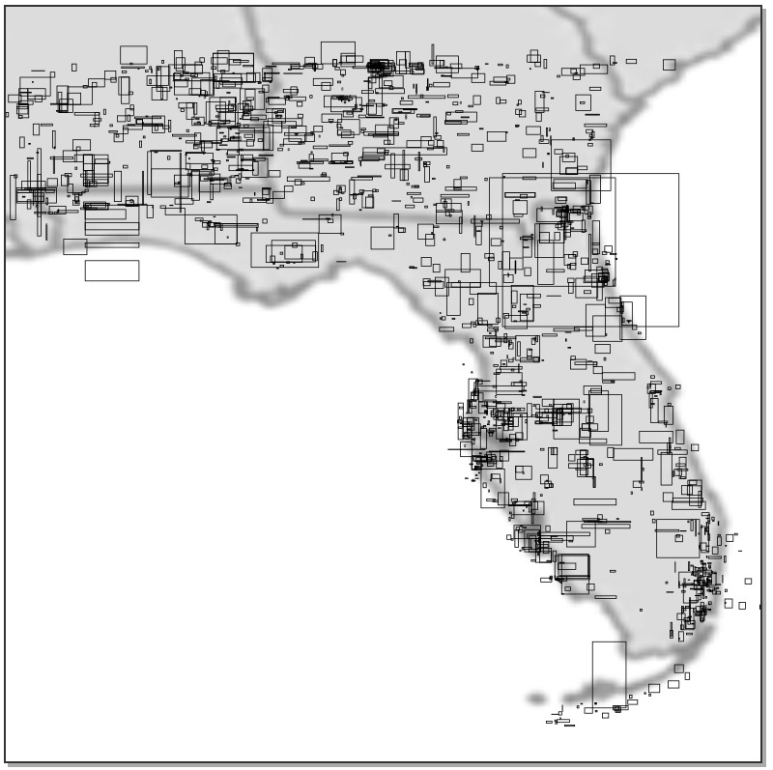
US storm events database
Overview of Florida [1953-2018]

Slide 38
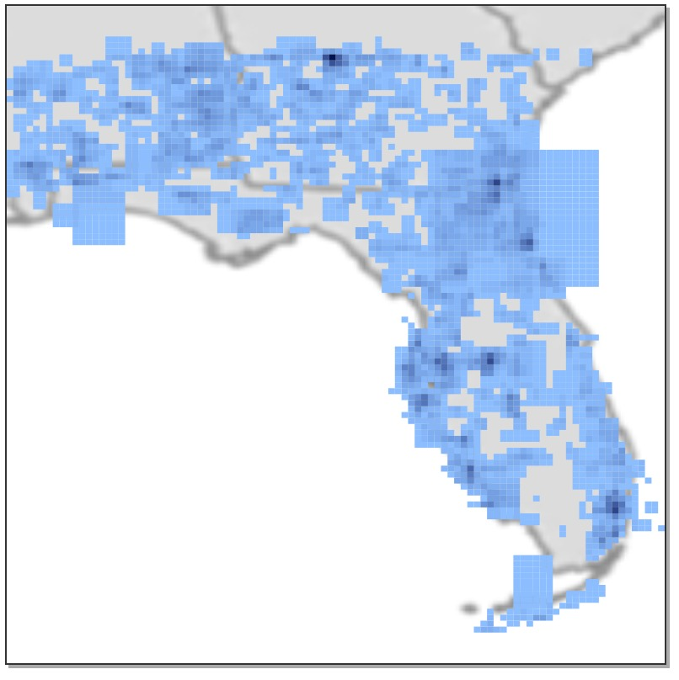
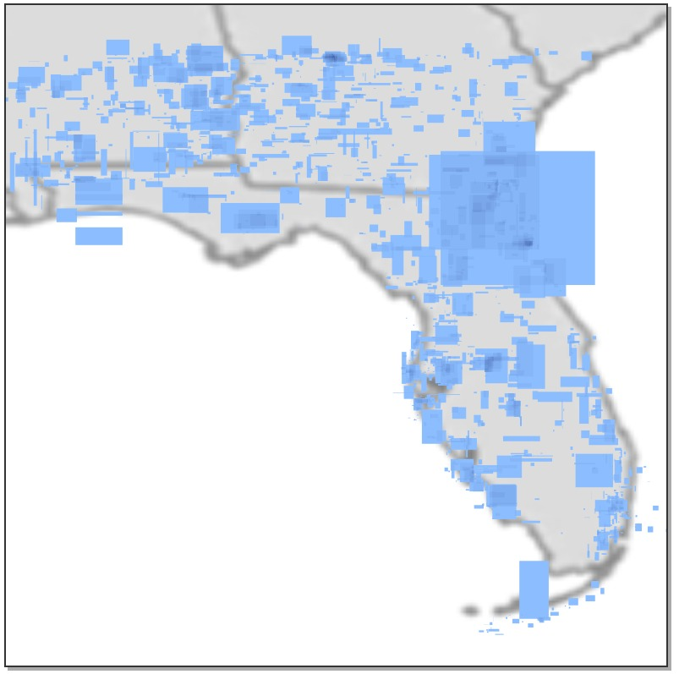
US storm events database
Grid-based visualization
OL-HeatMap

Slide 39
Proof-of-Concept Demo System

Slide 40
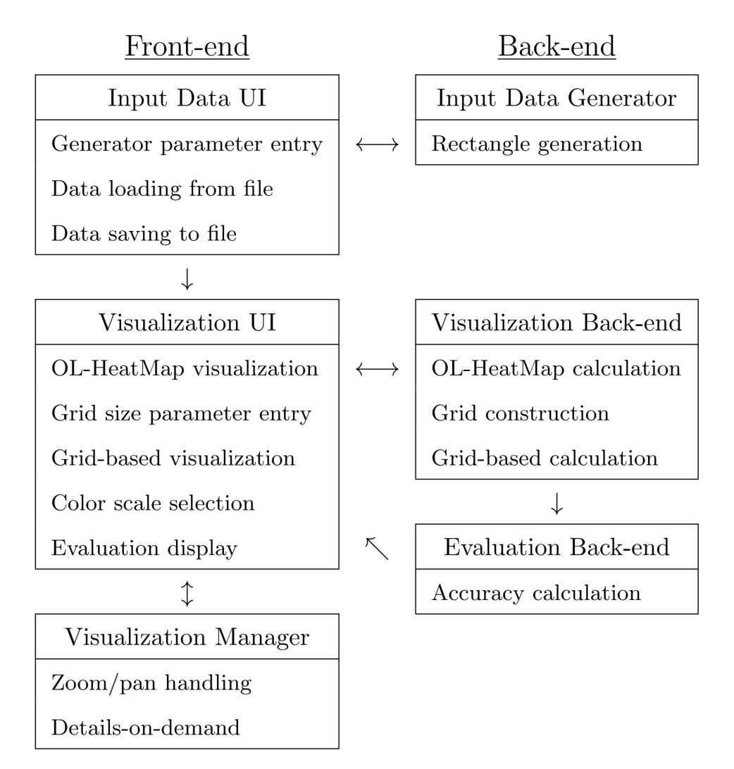
System overview

Slide 41
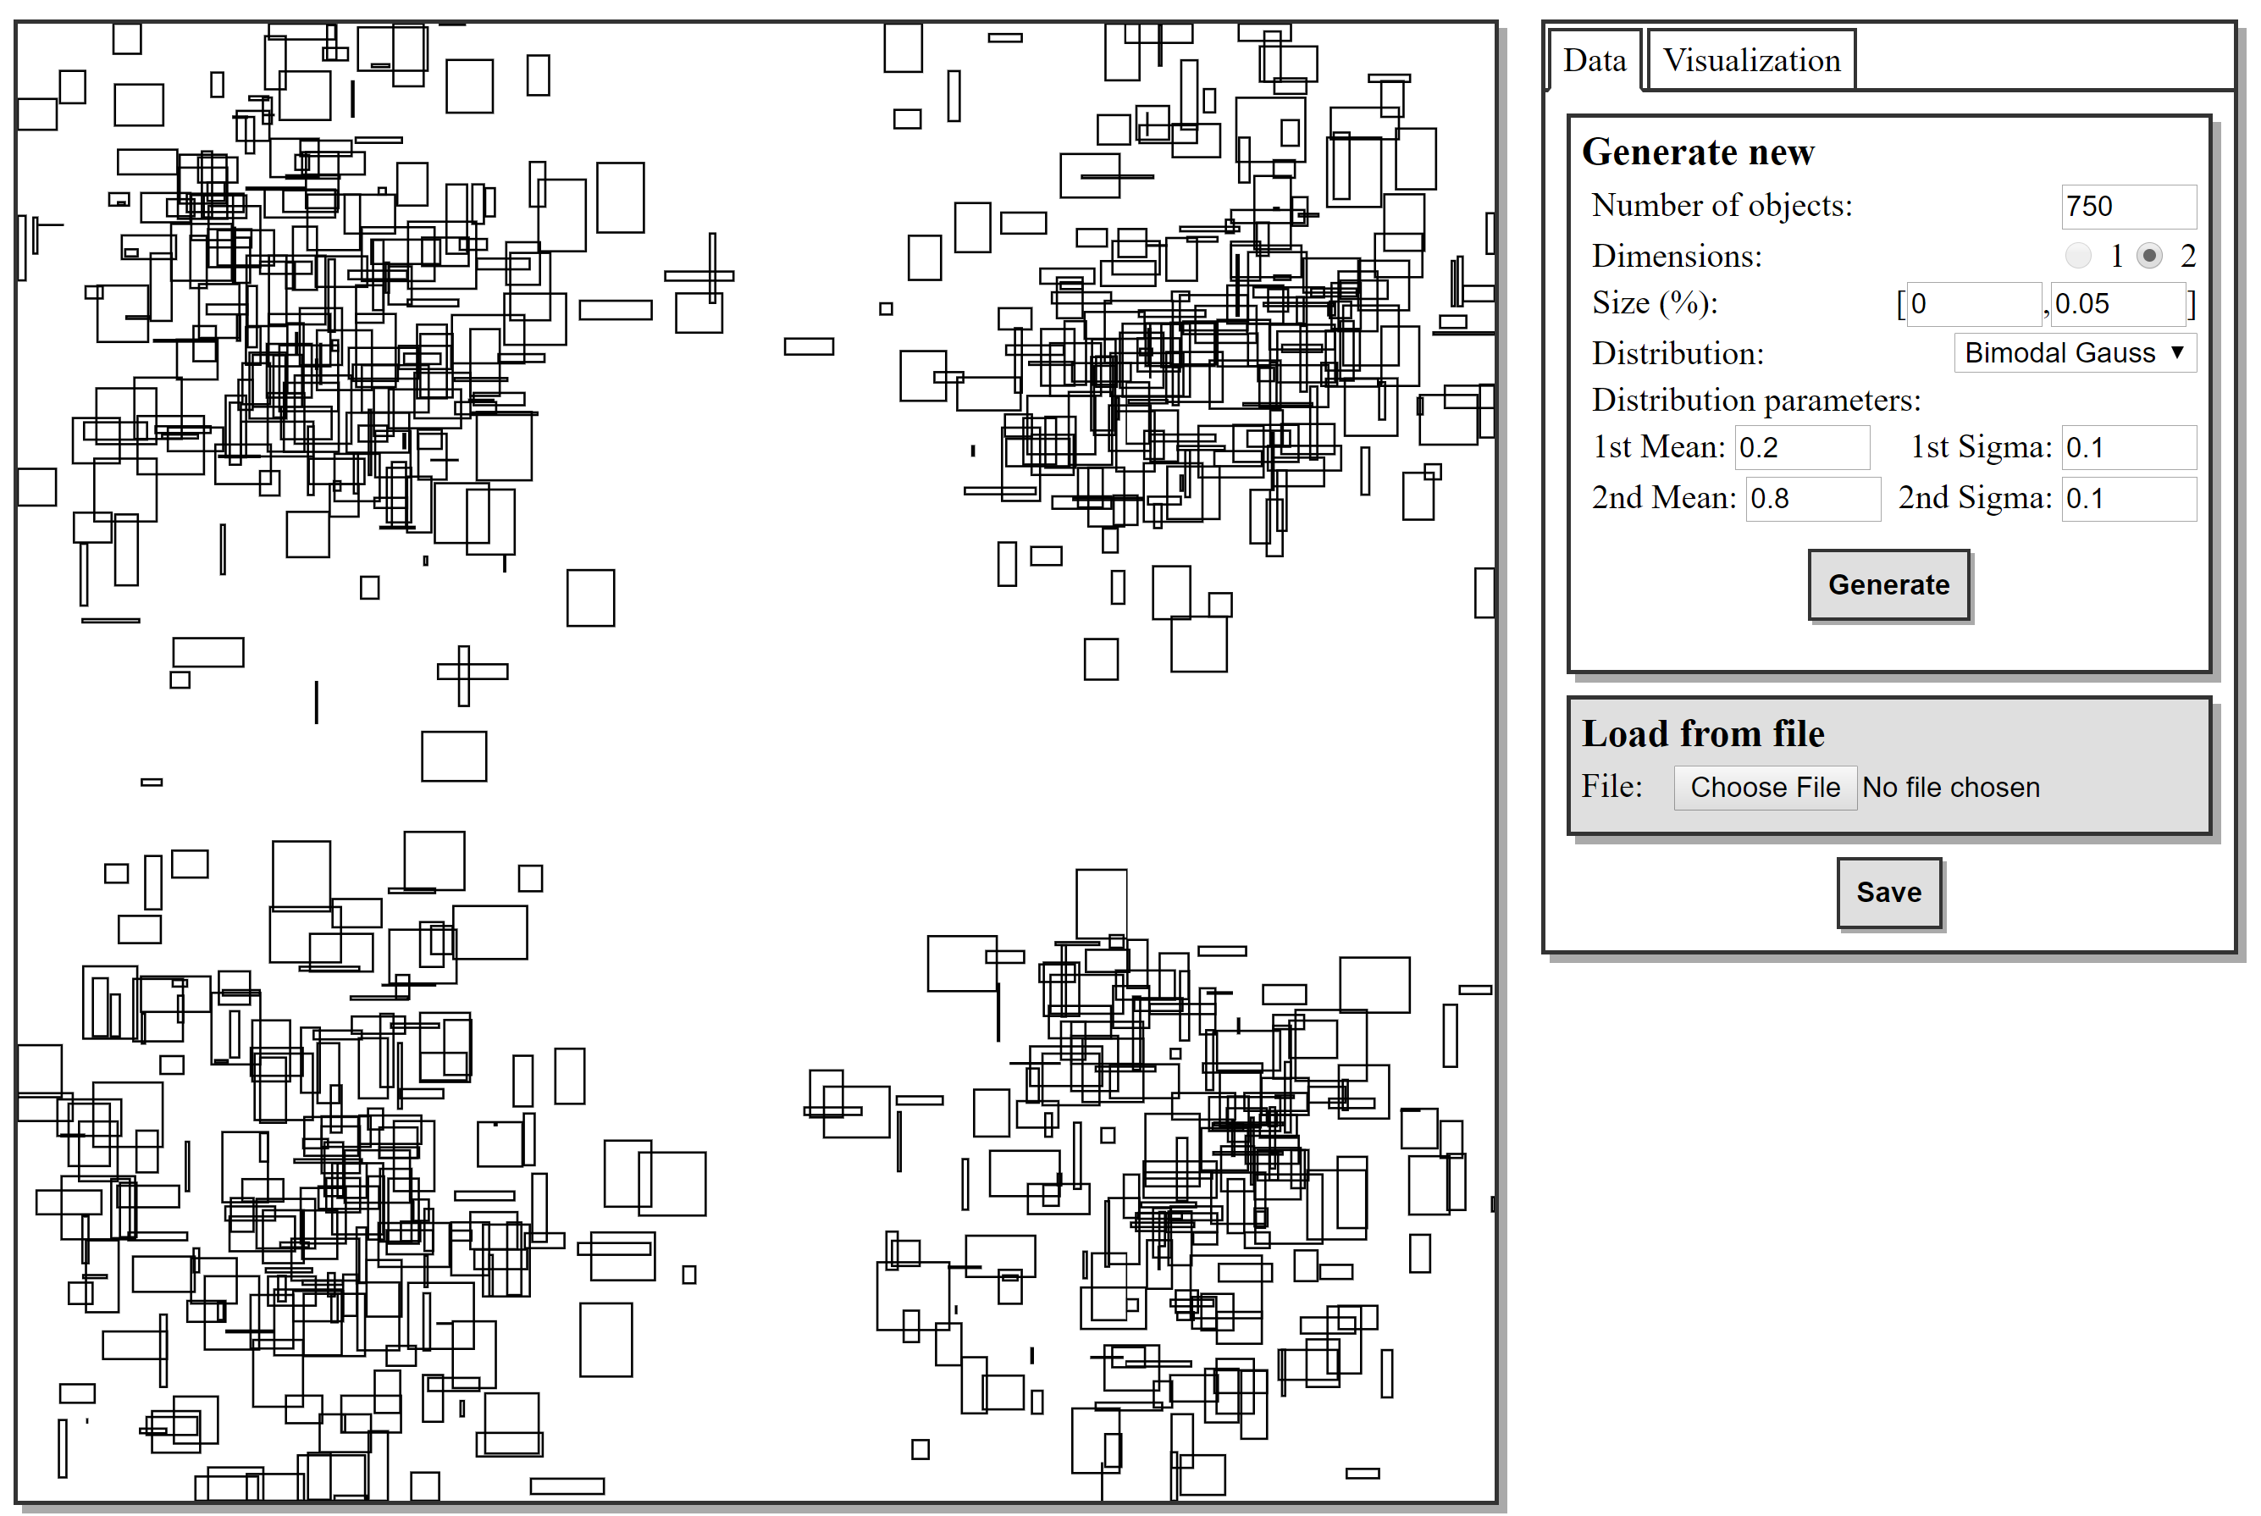
User interface
Input Data UI

Slide 42
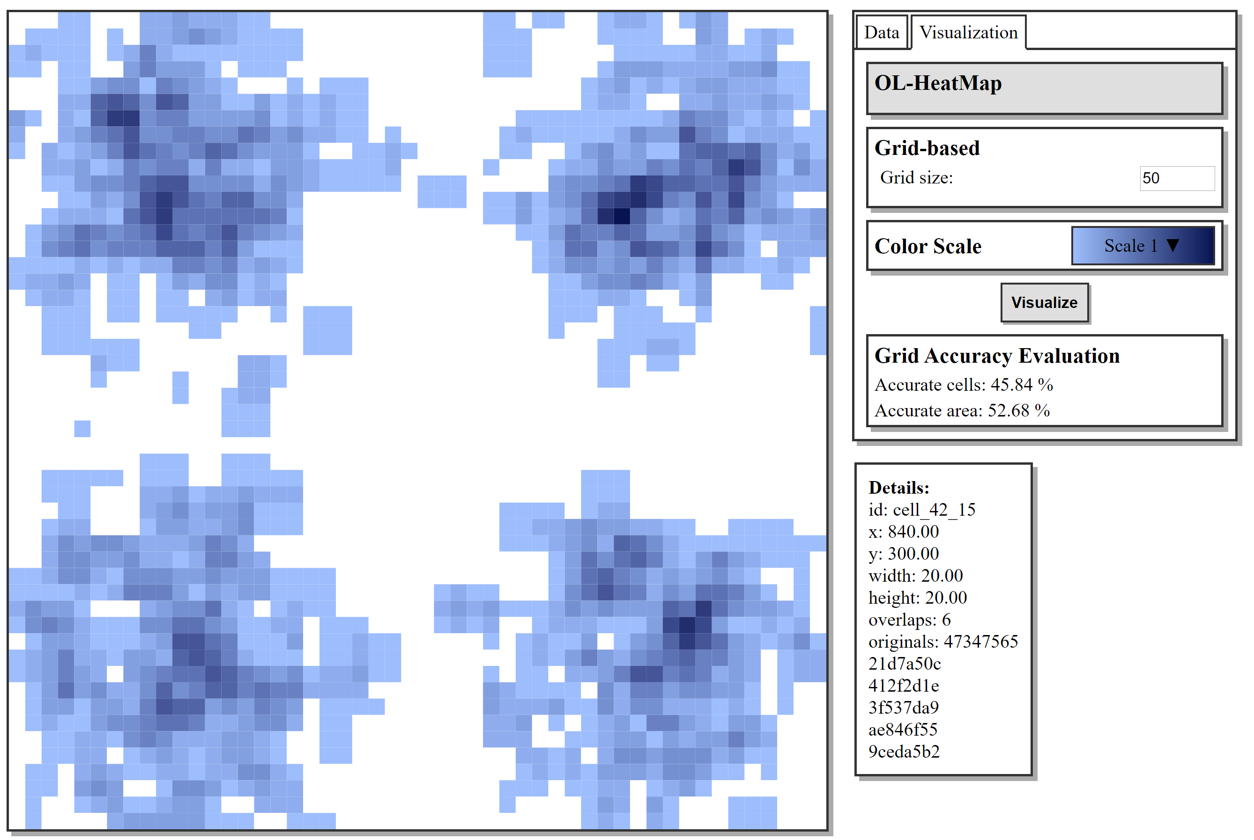
User interface
Visualization UI
Notes:
http://130.63.97.140:8080/

Slide 43
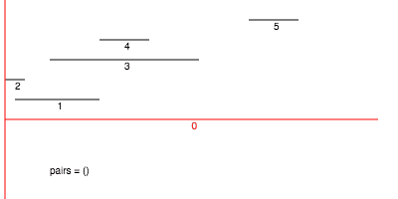
Take-away message
Finding multiple axis-aligned object intersections
OL-HeatMap – a powerful sweep-line based algorithm for finding density
OL-HeatMap properties:
fast
exact
versatile
Faster visualization rendering

Slide 44
Thank you!

Slide 45
Generated Synthetic Data:
t = 1
[B, D]
[C, E]
Input Matrix at t = 1:
A: 0
B: 1
C: 1
D: 1
E: 1
Goal:
Start with original graph.
Based on the above node data, reproduce the synthetic data.
Original graph with random-walks in bold:
A
B
C
D
E

Slide 46
Generated Synthetic Data:
t = 1
[A, B, C]
[A, B, D]
*Is this valid synthetic data?
Graph:
A
B
C
D
E

Slide 47
Questions?

